Slide 1
EENL (4212)
Modern American Novel
2010
Second Lecture
Mrs. Nouf Alkhattabi

Slide 2
An American Renaissance
The American Renaissance is the cultural rebirth that occurred in America during the 19th century.
Historically or culturally, it's the literary and cultural period from about 1820 to the 1860s--or, the generation before the American Civil War (1861-65), when the USA grew to its present size and began to deal with some of the unsolved issues remaining from the American Revolution.
In terms of literature or style, the American Renaissance is the "Romantic Period in American Literature."
The period's rich mix of literary style and cultural history makes it widely regarded as the greatest era in American literature.

Slide 3
Why is this period considered great?
Many authors experimented in style and developed themes important to American identity and expression
Rising readership and literacy increased with the development of industrial publishing. As with computer literacy today, basic literacy became important for leisure, social engagement, and power in literature, culture, scholarship, and politics.

Slide 4
Transcendentalism
It is a literary movement that depends on feelings and beliefs rather than a system of philosophy. Transcendentalists tried to find the truth through feelings and intuition not logic. Although the transcendentalists respected Christ for his wisdom, they rejected religion.
Nature is very important for transcendentalists, for natural images created a language, which allowed them to discover ideas already planted in the soul.

Slide 5
Some Famous Transcendentalist Quotes
“Wisdom does not inspect, it beholds.” (Thoreau)
“Go confidently in the direction of your dreams. Live the life you have imagined.” (Thoreau)
“Every object that speaks to the senses was meant for the soul.” (Granch)
“To believe in your own thought, to believe that what is true for you in your private heart is true for all men, - that is genius.” (Emerson)
“When the act of reflection takes place in the mind, when we look at ourselves in the light of thought, we discover that our life is embosomed in beauty.” (Emerson)

Slide 6
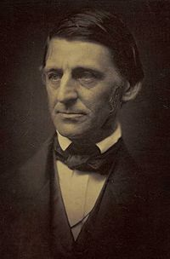

Ralph Waldo Emerson
Full name | Ralph Waldo Emerson
Born | May 25, 1803(1803-05-25) Boston, Massachusetts
Died | April 27, 1882 (aged 78) Concord, Massachusetts
Era | 19th century philosophy
Region | Western Philosophy
School | Transcendentalism
Signature

Slide 7
Ralph Waldo Emerson (1803-1882)
  Ralph Emerson founded the “Transcendentalist Club.” Its magazine The Dial was the true voice of their thoughts and feelings. There were two groups of transcendentalists: those who are interested in social reform, and those who are interested in the individual like Emerson.
  Emerson began his career as a minister and although he turned away from Christianity, he reminder a kind of preacher as he became a lecturer.
  Although he was a great essayist, his poetry was criticized as being awkward and unmusical, but to him does not always have to produce pleasant sounds. On the contrary, harsh sounds can be used to surprise the ear.

Slide 8
Some of Emerson’s Famous Works
Nature (1836): in it he stated that man should not see nature as something that should be used. His relation with it should transcend the idea of usefulness.
Self-Reliance (1841): a famous essay filled with memorable lines.
The Poet (1844): an essay that describes the poet as the complete man who frees us from old thoughts.
Concord Hymn: a poem that celebrates the Battle of Concord during the American Revolution.

Slide 9
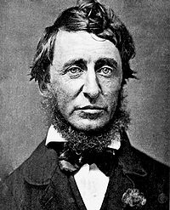
Henry David Thoreau
Maxham daguerreotype of Henry David Thoreau made in 1856.
Full name | Henry David Thoreau
Born | July 12, 1817(1817-07-12) Concord, Massachusetts
Died | May 6, 1862 (aged 44) Concord, Massachusetts
Era | 19th century philosophy
Region | Western Philosophy
School | Transcendentalism
Main interests | Natural history
Notable ideas | Abolitionism, tax resistance, development criticism, civil disobedience, conscientious objection, direct action, environmentalism, nonviolent resistance, simple living

Slide 10
Henry David Thoreau (1817-1862)
Thoreau was influenced by Nature and he along with Emerson held many similar opinions.
While Emerson wrote about nature in the abstract, Thoreau wrote more like an experienced woodsman and his works are full with details about plants, rivers and wildlife.
His poetry is far less important than Emerson’s. However, his prose sentences sound like poetry.
Around the 1850s, he became interested in Abolitionist movement. His home became a meeting place for anti-slavery groups. He, himself, helped slaves escape to freedom.

Slide 11
Some of Thoreau’s Famous Works
Civil Disobedience (1849): is about his experience in jail when he was arrested for refusing to pay his taxes because of his protest against slavery and the war against Mexico. This essay had great influence on Ghandi, Tolstoy and Martin Luther King.
Walden (1854): is one of the greatest works in American literature. It is about his stay in the hut, which he, himself, built on the north shore of Walden Pond. On the surface it is about the practical side of living in the woods, but in fact it is completely a transcendentalist work. He emphasizes that enjoyment comes only when unnecessary things are thrown away.

Slide 12
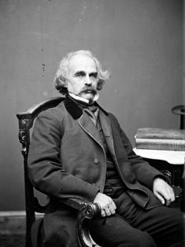
Nathaniel Hawthorne in the 1860s
Born | July 4, 1804(1804-07-04) Salem, Massachusetts, United States
Died | May 19, 1864 (aged 59) Plymouth, New Hampshire, United States
Occupation | Novelist, Short story writer, Custom House worker, United States Consul
Literary movement | Dark Romanticism

Slide 13
Nathaniel Hawthorne (1804-1864)
Hawthorne attacked transcendentalism, for he wrote about man in society not in nature.
His characters usually have some secret guilt which keeps them apart from other people. They are troubled by pride, envy and a desire to revenge. This dark side of the human nature gives Hawthorne’s works some of the Gothic characteristics.
Hawthorne was very much interested in describing the psychology of his characters.
He wrote many works, but his most famous is The Scarlet Letter.

Slide 14
The Scarlet Latter (1850)
Set in the 17th century Puritan Boston, The Scarlet Letter, teory of Hester Prynne, who leaves England for the Massachusetts Bay colony, seeking a sense of independence as she awaits the arrival of her husband. As time passes and her husband is thought to be killed by Indians, Hester falls for a young pastor named Arthur Dimmesdale. When their affairs produces a child, Hester is publicly humiliated and forced to wear a scarlet "A" to punish her for adultery. That same day, her husband returns, calling himself by a new name, and seeks revenge against Hester and her lover.
The novel explores themes of legalism, sin, and guilt.

Slide 15
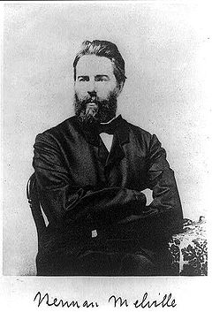
Photograph of Herman Melville
Born | August 1, 1819(1819-08-01) New York City, New York, U.S.
Died | September 28, 1891 (aged 72) New York City, New York, U.S.
Occupation | Novelist, short story writer, teacher, sailor, lecturer, poet, customs inspector
Nationality | American
Genres | Travelogue, Captivity narrative, Sea story, Gothic Romanticism, Allegory, Tall tale
Literary movement | Romanticism, Dark Romanticism, and Skepticism.

Slide 16
Herman Melville (1819-1891)
Melville has a tragic view of life: he feels that the universe works against human happiness and peace of mind. In his fiction, man lives in a world divided into two parts: good against evil, the head against the heart
His most important experience in life stated when he became a sailor at the age of twenty. He was shocked by the life and morality of the low-class sailors. Hence, life at the sea became the most important material for his works. As a matter of fact, he could this experience “my Harvard and my Yale.”

Slide 17
Moby- Dick (1851)
Moby-Dick was originally misunderstood by its contemporary audiences and critics. It is now often referred to as The Great American Novel and is considered one of the treasures of world literature. The story tells the adventures of the wandering sailor Ishmael and his voyage on the whale ship Pequod, commanded by Captain Ahab. Ishmael soon learns that Ahab seeks one specific whale, Moby Dick, a white sperm whale of tremendous size. Comparatively few whale-ships know of Moby Dick, and fewer yet have encountered him. In a previous encounter, the whale destroyed Ahab's boat and bit off his leg. Ahab intends to take revenge.
In Moby-Dick, Melville employs , symbolism and metaphor to explore numerous complex themes.

Slide 18
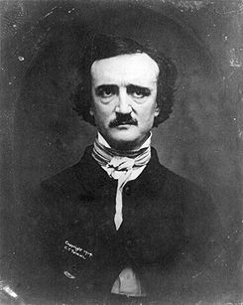
Edgar Allan Poe
Born | January 19, 1809(1809-01-19) Boston, Massachusetts, USA
Died | October 7, 1849 (aged 40) Baltimore, Maryland, USA
Occupation | Poet, short-story writer, editor, literary critic
Genres | Horror fiction, Gothic romance, crime fiction, detective fiction, comedy, satire
Literary movement | Romanticism

Slide 19
Edgar Allan Poe (1809-1849)
Similar to Melville, Poe was interested in psychology and the dark side of human nature. Because of his parents’ death he faced many hardships and unhappiness.
He contributed to American Literature in three areas: poetry, short story and literary criticism. His tales of horror are well known. He puts his characters in unusual situations. Then, he would describe their feelings of guilt and terror. The Fall of the House of Usher (1839), is the best known of Poe’s tales.
Poe was also one of the creators of modern detective stories. Instead of examining characters’ feelings, these stories examine mysteries or problems.
What distinguishes Poe’s poetry is its sounds not content. He felt that the goal of poetry is to please not to tell the truth. However, according to him pleasure does not mean happiness. Rather a good poem creates a feeling of gentle sadness. The Raven (1845), is his most famous poem.

Slide 20
The Boston Brahmins
The term "Boston Brahmins" refers to a class of wealthy, educated, members of Boston society in the nineteenth century. The Boston Brahmins have long held the interest of historians because of their unique place in nineteenth-century American culture. They were mostly the descendants of Puritans, having made their fortunes as American merchants. They were the closest thing the United States has ever had to a true aristocracy.
Although the Brahmins looked to England for excellence and often copied English literary styles, they considered Boston “the thinking center of the American continent, and therefore the planet.” Through Their magazine Atlantic Monthly, they tried to influence the taste of the public.

Slide 21
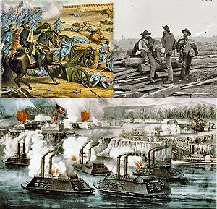
American Civil War
Date | April 12, 1861 – April 9, 1865 (last shot ended June, 1865)
Location | Principally in the Southern United States
Result | Union victory; Reconstruction; slavery abolished; national government strengthened; South impoverished

Slide 22
The Civil War (1861-1865)
The American Civil War lasted from 1861 until 1865. The southern states wanted to have their own nation and be able to decide what laws to have. The north did not want the country to be broken apart. In the election of 1860 Abraham Lincoln stated that he wanted to stop the spread of slavery. The southern states said that if Lincoln won, they would secede (leave) the union. The southern states seceded from the union after Lincoln was elected. They formed their own nation, The Confederate States of America. The war began in April of 1861 and president Lincoln was forced to declare war. The war was a long and bloody. Over 600,000 men on both sides died. Over 1,100,000 were injured. The south was devastated. General Lee (south) surrendered to General Grant (north) on April 9, 1865 at Appomattox Court House in Virginia. The war was over.

Slide 23
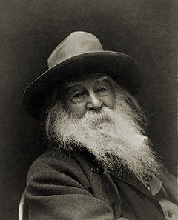
Walt Whitman, 1887
Born | May 31, 1819(1819-05-31) West Hills, Town of Huntington, Long Island, New York, U.S.
Died | March 26, 1892 (aged 72) Camden, New Jersey, U.S.

Slide 24
Walt Whitman (1819-1892)
Whitman education came from early jobs of printing shops and newspapers, rather from schools. However, while most young Americans were working hard, he was a lazy youth who took long walks in the country and by the seashore.
During the Civil War, he supported the North. He worked as a nurse in the battle fields because he was too old to fight
His works express a joyous curiosity about every detail of life. In his poems, he likes to ‘absorb’ the sights, sounds and smells and then ‘sing’ them out in poetry.
Through Whiteman, American poets freed themselves from the old English traditions. To him the message of a work is more important than the form and he was the first to experience free verse (a poetry in a form that does not follow a regular pattern). He wrote poetry without any poetic ornaments in order for the regular man to understand. Leaves of Grass, is his life work. The book changed as he and his country grew and changed, for he saw reality as a continuous flow without a beginning and an end. Therefore, from 1855 until the last revision in 1892, Leaves of Grass remained ‘a work in progress.’

Slide 25
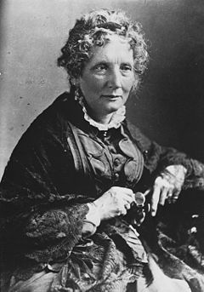
Born | Harriet Elisabeth Beecher June 14, 1811(1811-06-14) Litchfield, Connecticut, U.S.
Died | July 1, 1896 (aged 85) Hartford, Connecticut, U.S.
Pen name | Christopher Crowfield
Nationality | American
Genres | Historical fiction
Notable work(s) | Uncle Tom's Cabin

Slide 26
Harriet Beecher Stowe (1811-1896)
Harriet Beecher was the daughter of outspoken religious leader Lyman Beecher. She was the sister of the educator and author, Catharine Beecher, clergymen Henry Ward Beecher and Charles Beecher. Harriet enrolled in the seminary run by her eldest sister Catharine, where she received a traditionally "male" education. In 1836 she married Calvin Ellis Stowe, a professor at the seminary and a critic of slavery. The Stowes supported the Underground Railroad and housed several fugitive slaves in their home.
Stowe was a small lady that wrote a big book. President Lincoln greeted her “so you’re the little woman who made the book that made the great war.” Stowe’s Uncle Tom’s Cabin (1852) united Northern feelings against slavery.
Hundreds of thousands of copies were sold in America before the Civil War; since then it has been translated to twenty languages and millions of copies have been sold worldwide.

Slide 27
Uncle Tom’s Cabin (1852)
Uncle Tom's Cabin was the best-selling novel of the 19th century, and the second best-selling book of that century, following the Bible. It is about the old slave, Uncle Tom who hopes for freedom, but never escapes. In the end, he welcomes death caused by his cruel master.
In response to Uncle Tom's Cabin, writers in the Southern United States produced a number of books to rebut Stowe's novel. This so-called Anti-Tom literature generally took a pro-slavery viewpoint, arguing that the issues of slavery as depicted in Stowe's book were overblown and incorrect.

Slide 28
The Gilded Age
In American history, the Gilded Age refers to substantial growth in population in the United States and extravagant displays of wealth and excess of America's upper class during the post-Civil War and post-Reconstruction eras of the late 19th century (1865-1901). The term "Gilded Age" was coined by Mark Twain and Charles Dudley Warner in their 1873 book, The Gilded Age: A Tale of Today.
Many refer to this period as a new ‘Golden Age.’ But the gold was only on the surface. Underneath, American society was filed with crime, corruption and social injustice.

Slide 29
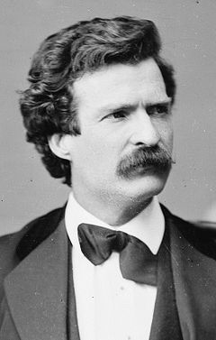
Born | November 30, 1835(1835-11-30) Florida, Missouri, U.S.
Died | April 21, 1910 (aged 74) Redding, Connecticut, U.S.
Pen name | Mark Twain
Occupation | Writer, lecturer
Nationality | American
Genres | Fiction, historical fiction, children's literature, non-fiction, travel literature, satire, essay, philosophical literature, social commentary, literary criticism
Notable work(s) | Adventures of Huckleberry Finn, The Adventures of Tom Sawyer

Slide 30
Mark Twain (1835-1910)
Growing up beside the Mississippi river allowed Twain to hear stories of Indians and black slaves. Because of his love for adventure, he worked on one of the river boats until the war destroyed the riverboat business. From there, he worked in a newspaper which sent him in 1867 to Europe. His letters from there were collected into a book The Innocent Abroad (1869) which shows his hatred of European aristocracy.
Throughout his works, there is a conflict between the ideals of Americans and their desire for money. Twain never tried to solve the conflict. Just like a newspaperman, he reports what he sees.
Some critics argue that Twain only wrote well, when he was writing about young people. They say his psychology was only child psychology.
In his later works, Twain seems less hopeful about democracy. His pessimism grew deeper and deeper

Slide 31
The Adventures of Huckleberry Finn (1884)
The Adventures of Huckleberry Finn is Twains greatest novel. He gives his young hero adult problems. out Huck and an escaped slave, Jim, float down the Mississippi River on a raft. During their trip, Huck learns about the evils of the world. He, himself, faces a moral problem. The law of the society says he should return Jim to his owner. But, then he decides that the slave is a man not a thing. So, he decides to break the law and is no longer a child.
Many consider the novel as the great novel of American democracy. It shows the basic goodness and wisdom of ordinary people.

Slide 32
THANK YOU

